Slide 1
Seminar 2
2016/03/25

Slide 2
In 2 weeks
1st week: Reading papers and articles
2nd week: Having a idea

Slide 3


Slide 4



Slide 5
Sharing emotions and helping people escape from negative emotions

Slide 6
How to detect emotion ?
Camera
Voice Recognition
Biomedical sensors:
EMG – Muscle tension
EDA – Skin Conductance
ECG – Heart rate
EEG – Brain wave
by the most accurate way

Slide 7
How to help people escape from negative emotions?
Express emotions by color LED
Automatically find music
Keep people calm down
Give a piece of advice

Slide 8
Technology:
Schematic:
MCU
Biomedical sensors
Digital Signal Processing
Voice Processing
Database
Android/ iOS
Psychology
Design product
Digital Processing
Fashion Clothes:
IMU
EEG
ECG
EDA
EMG
Display
Information
Find music
Advice
Talking like Contana
MCU
wireless
Analysis
Voice Processing
Smart Phone

Slide 9
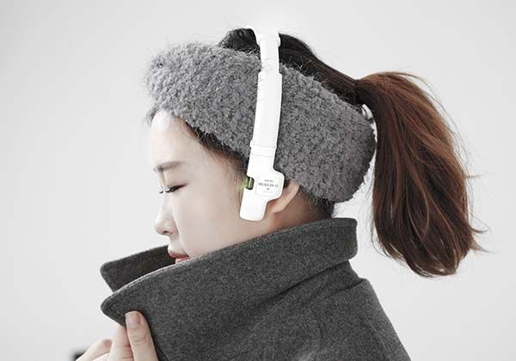
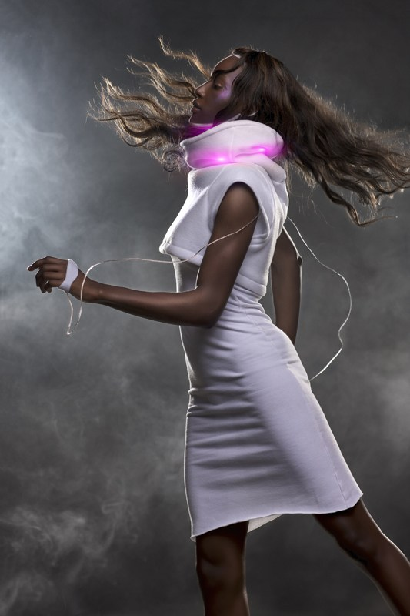
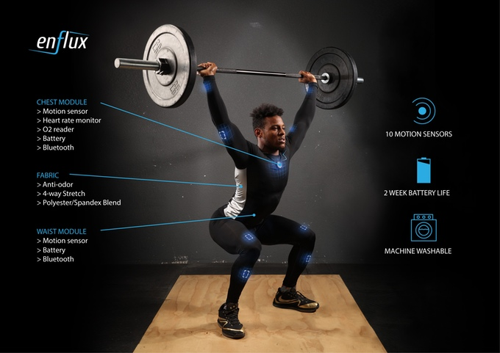
For more:
Change temperature of clothes
Health Tracking
Sleep Tracking
Fitness
Fashion and Portable

Slide 10
Thank you!

